Slide 1

Housing Project
Submitted by:
Alivia Dasgupta

Slide 2

OUTLINE
Introduction
Problem Statement
Project Specification
Dataset
Pipeline
Data Cleaning
Feature Engineering
Model Creation
Result/Output

Slide 3

1. Introduction
In this Project, We have built a machine learning model to predict the house prices of an Australian city.
The project will very helpful for the real estate market.
Our model can be used by the both house sellers and house buyers.
Multiple Linear Regression algorithm is used to create a model with a great accuracy score.

Slide 4

2. Problem Statement
Prices of real estate properties are sophisticatedly linked with our economy.
Despite this, we do not have accurate measures of house prices based on the vast amount of data available.
Proper and justified prices of properties can bring in a lot of transparency and trust back to the real estate industry,
Which is very important for most consumers especially in Australia.

Slide 5

3. Project Specification
The goel of this project is to predict house prices in Australian city based on some features such as
LotArea, LotShape, LandContour, Neighborhood, BldgType, HouseStyle, OverallQual, OverallCond,YearBuilt
YearRemodAdd, RoofStyle, RoofMatl, Exterior1st, Exterior2nd, BsmtQual, BsmtCond, BsmtExposure, BsmtFinType1, BsmtFinSF1, GarageYrBlt, GarageArea, YrSold , SaleType, SalePrice.
Australia house price dataset is used to create the model.
We are using Machine Learning algorithm to create a predicative model.
Multiple linear Regression algorithm is used to train and test the model in our project.
Import the data.

Slide 6
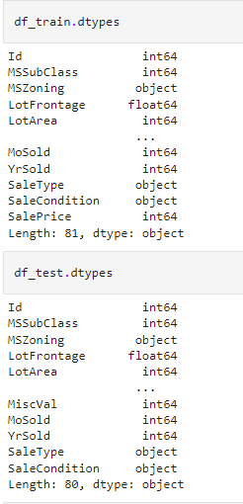
4. Dataset
Dataset comes from our organization.
There are 1168 number of observations in our train dataset .
There are 292 number of observations in our test dataset.
The all 81 columns are available in our train dataset.
The all 80 columns are available in our test dataset.
We have used a total of 5 features to train and test dataset.

Slide 7
3. Pipeline
Data Cleaning
Features Engineering
Outlier Detection
OutlierRemoval
Model Creation

Slide 8

4. Data Cleaning
The main aim of Data Cleaning is to identify and remove errors & duplicate data, in order to create a reliable dataset.
The process of data cleaning is done by using a very famous library Pandas.
Initially , those columns/ features are dropped from our dataset who are not important in deciding the final price.
The rows having a null value in any columns are dropped from our dataset.
The columns having characters as well as integer values are converted into integer value only.
Many more data cleaning techniques are used to improve the quality of our dataset.

Slide 9
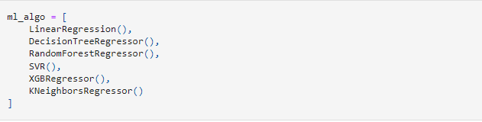
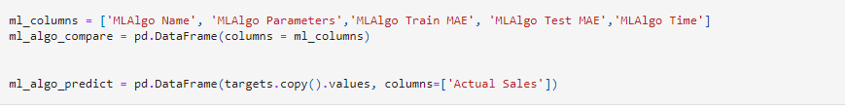
5. Feature Engineering
Feature engineering is the process of using domain knowledge of extract features from raw data via data mining techniques.
These features can be used to improve the performance of machine learning algorithms. Feature engineering can be considered as applied machine learning itself.
Dimensionality reduction techniques are used in our dataset to reduce those rows who are not very much important
to decide the house price.

Slide 10
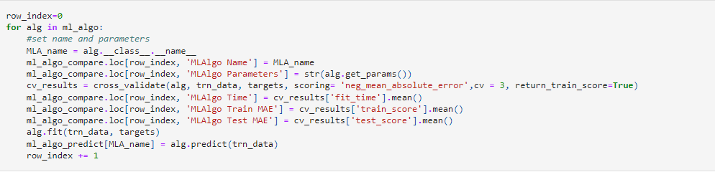
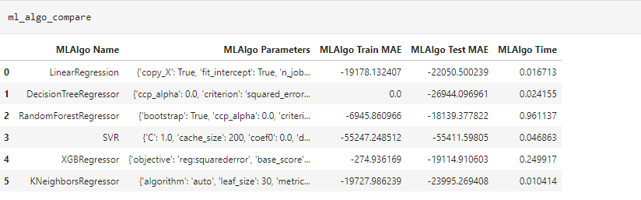

Slide 11
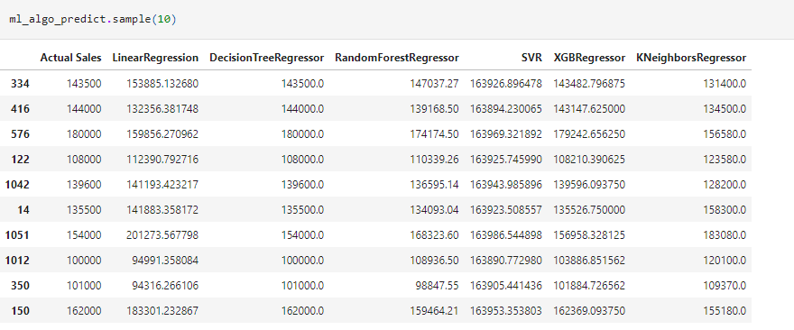
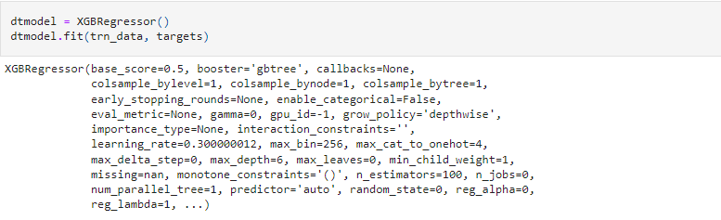

Slide 12
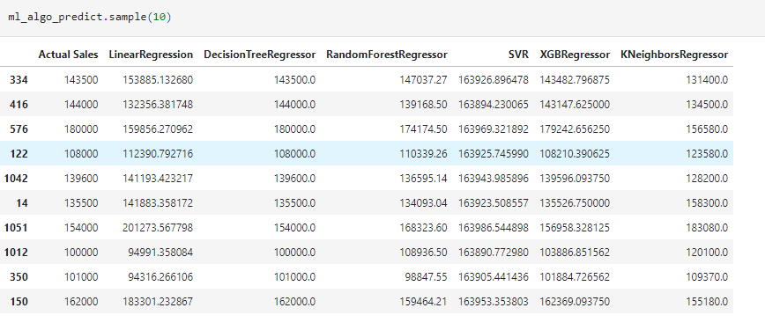
Model Creation
The process of modeling means training a machine learning algorithm to predict the labels from the features.
We have used Linear Regression algorithm for training and testing of the model.
The accuracy rate of our model is pretty good.

Slide 13
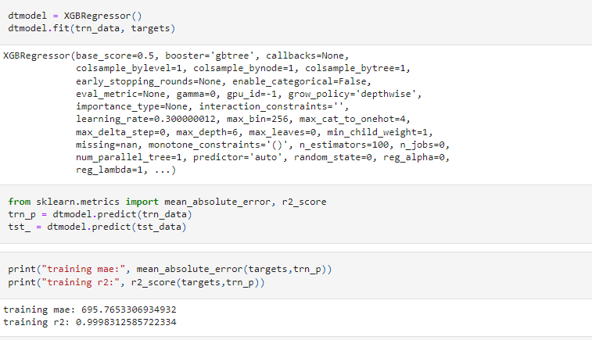

Slide 14
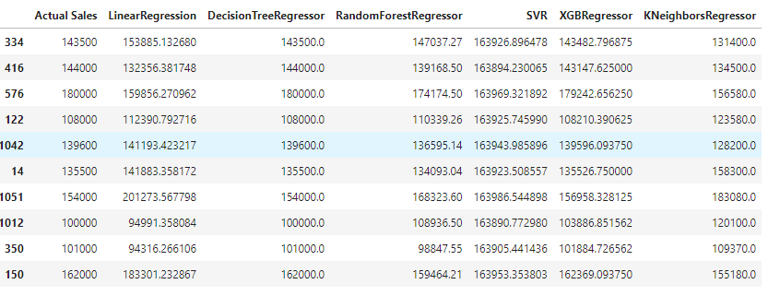
Result/Output
We created a function to predict the house price .
Our function be like “ Predict Price LotArea, SaleType, etc”
When we pass the values into our function, It will predict house price to us.

